Slide 1
Ferramentas de versionamento:
Git
Daniel Brito, Daniel Terra, João Dias

Slide 2
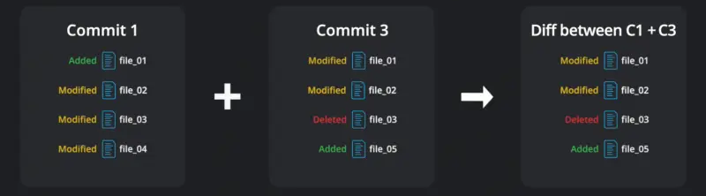
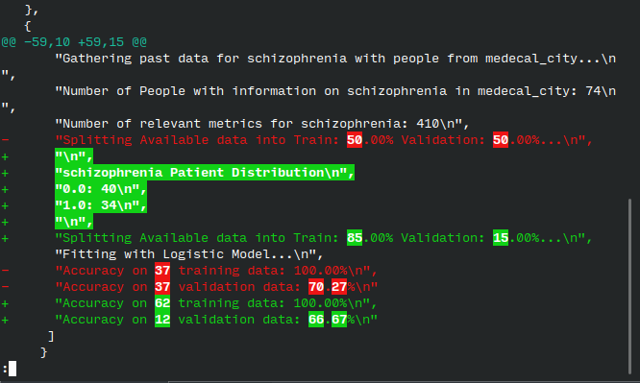
Criação
DIFF
Data de criação

Slide 3
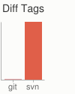
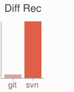
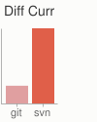
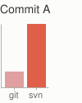
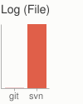
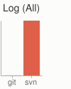
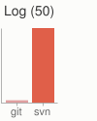
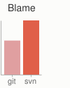
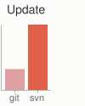
Git ou SVN?
Stackoverflow survey: 93.87% VS 5.18%
Centralizado ou Distribuído?
C: SVN e Team Foundation Server
D: Git e Mercurial
E se o server cair?
Travado VS sincronizar com repositórios locais
Notes:
https://youtu.be/2ReR1YJrNOM
https://git-scm.com/about/small-and-fast

Slide 4
Git ou SVN?
Operation | Git | SVN | Ratio | Description
Commit Files (A) | 0.64 | 2.60 | 4x | Add, commit and push 113 modified files (2164+, 2259-)
Commit Images (B) | 1.53 | 24.70 | 16x | Add, commit and push a thousand 1 kB images
Diff Current | 0.25 | 1.09 | 4x | Diff 187 changed files (1664+, 4859-) against last commit
Diff Recent | 0.25 | 3.99 | 16x | Diff against 4 commits back (269 changed/3609+,6898-)
Diff Tags | 1.17 | 83.57 | 71x | Diff two tags against each other (v1.9.1.0/v1.9.3.0)
Log (50) | 0.01 | 0.38 | 31x | Log of the last 50 commits (19 kB of output)
Log (All) | 0.52 | 169.20 | 325x | Log of all commits (26,056 commits – 9.4 MB of output)
Log (File) | 0.60 | 82.84 | 138x | Log of the history of a single file (array.c – 483 revs)
Update | 0.90 | 2.82 | 3x | Pull of Commit A scenario (113 files changed, 2164+, 2259-)
Notes:
https://youtu.be/2ReR1YJrNOM

Slide 5






Git ou GitHub?
Sistema de controle de versão
Git
Mercurial
Subversion
Plataforma de controle de versão
Bitbucket
GitHub
GitLab
Notes:
https://survey.stackoverflow.co/2022/#section-version-control-version-control-systems

Slide 6
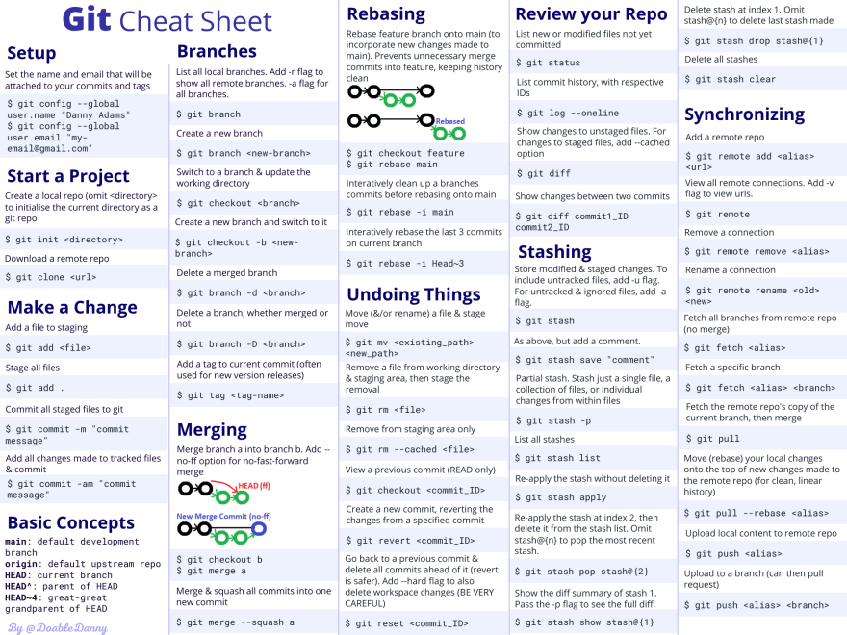
Vocabulário e comandos
Notes:
https://zarkom.notion.site/zarkom/Introduction-to-Git-ac396a0697704709a12b6a0e545db049

Slide 7
Obrigado!
Ferramentas de versionamento: Git

